Slide 1
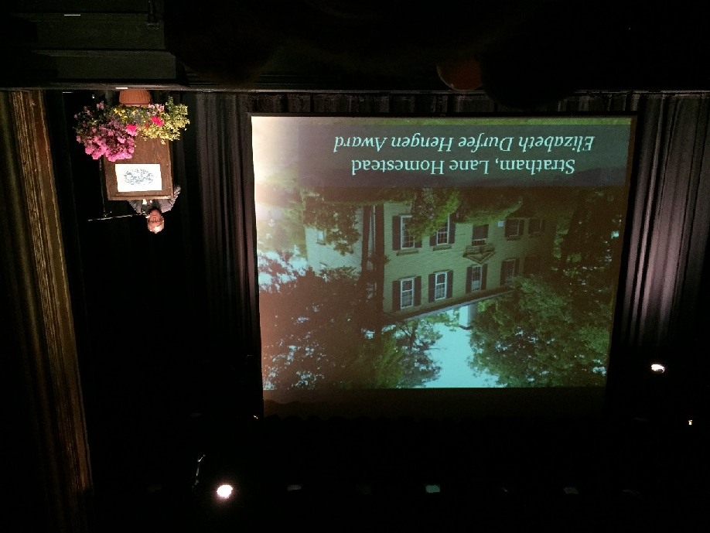
Town of Stratham receives
Preservation Achievement Award
for its outstanding preservation of the
Lane Homestead

Slide 2
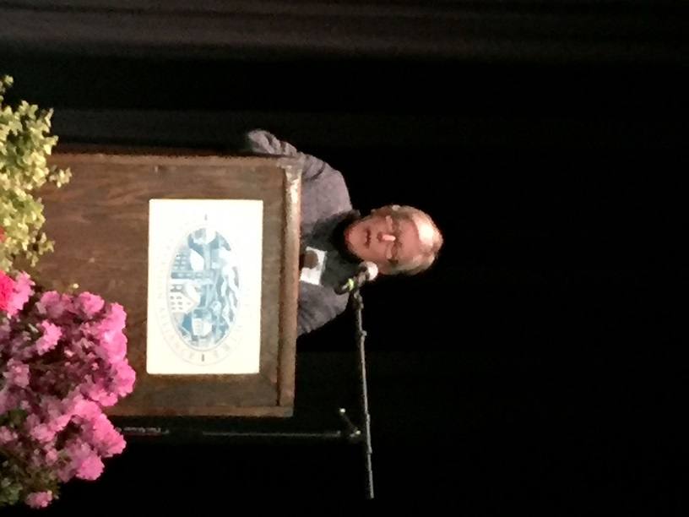

Slide 3
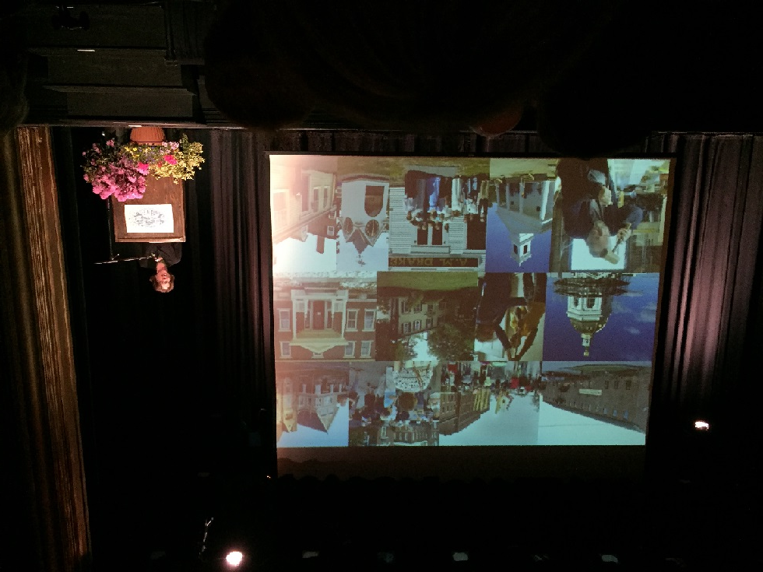

Slide 4
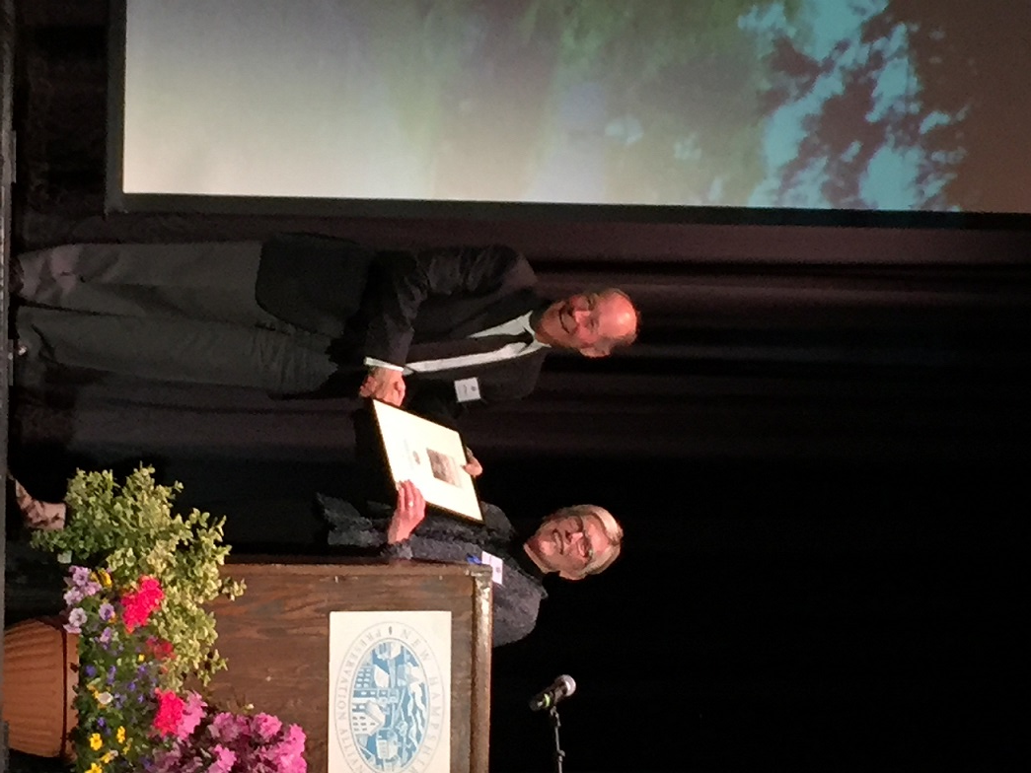

Slide 5
